Slide 1
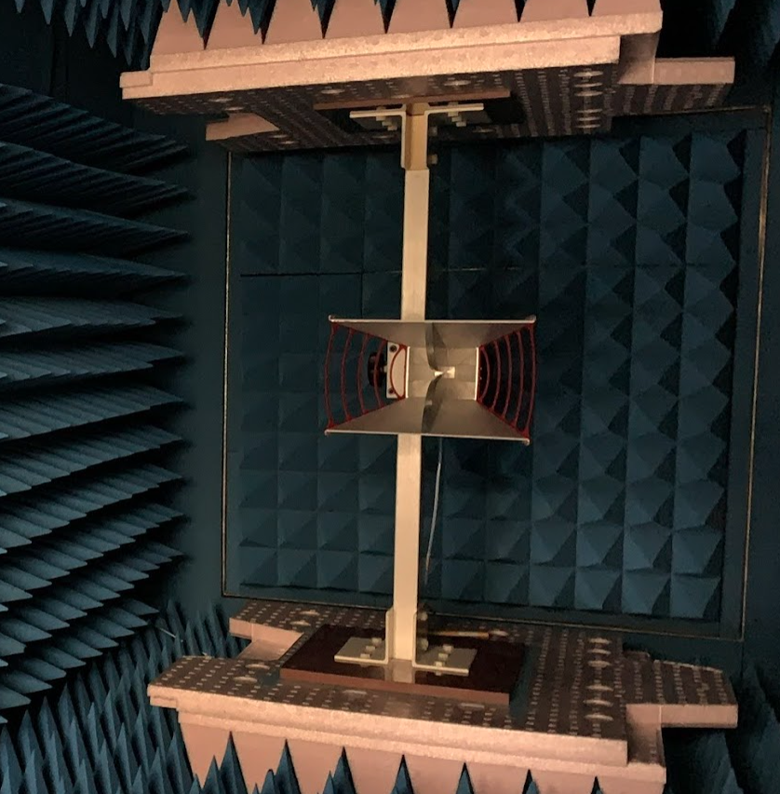
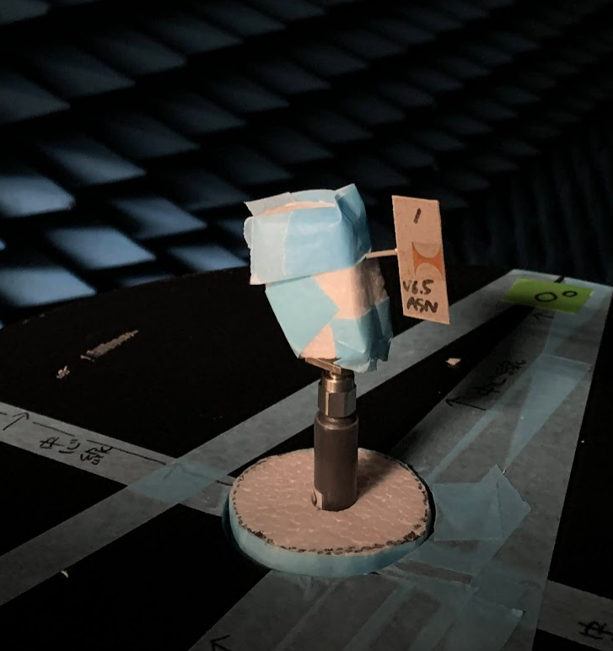
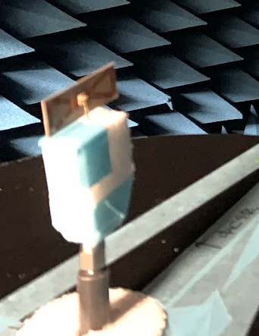
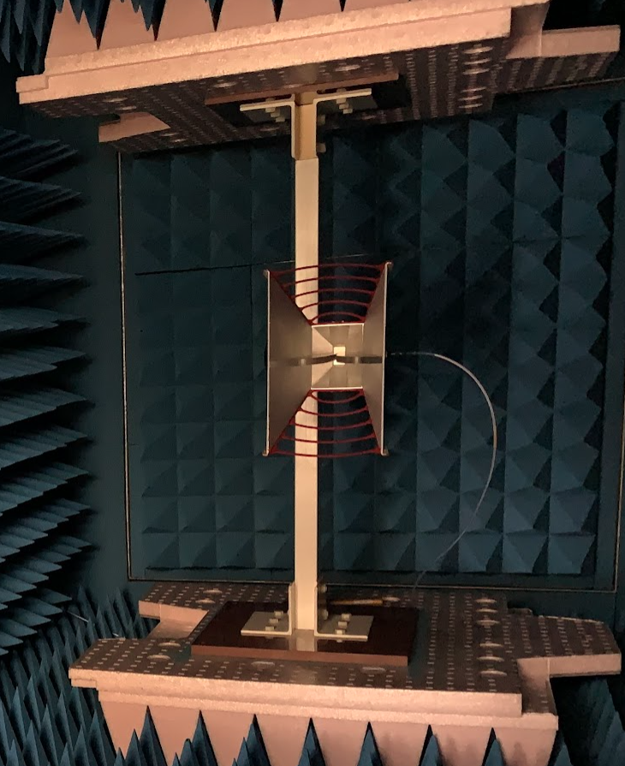
Filename Suffix | DUT Ant: Vertical Position | DUT Ant: Horizontal Position
Monitor Ant: Vertical Position | (1) VV | (2) VH (*1)
Monitor Ant: Horizontal Position | (3) HV | (4) HH (*1)
Monitor Antenna
DUT Antenna
Vertical Position
(H-Plane for a dipole)
Horizontal Position (*1)
(E-Plane for a dipole)
Vertical Position
Horizontal Position
*1 … Reverse rotation to HFSS radiation polar chart

